Slide 1
Injector Refurb Program
Complete Rebuild of Injectors.

Slide 2
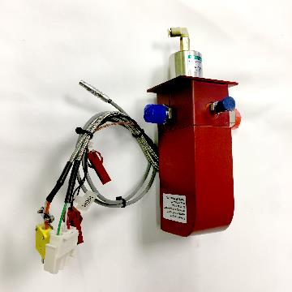
Assessment
Injectors go through a
5 point test
Injection rate
Temperature
Clog/Leak check
Nupro function
Piezo function/Calibration

Slide 3
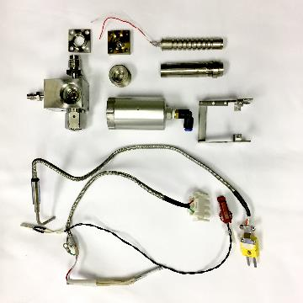
Tear Down
Injectors are “torn down”
into individual parts,
Inspected, then fixed
or replaced.

Slide 4
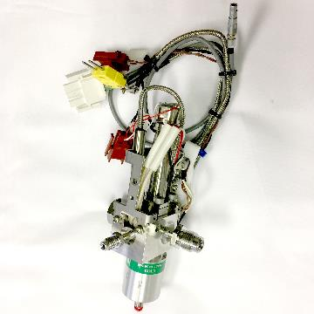
Rebuild and Test
Injectors are then rebuilt
and tested.

Slide 5
Clean and Ship
Once an Injector passes
Our 5 point inspection it is
cleaned and given a
certification sticker with a
calibration due by date.

