Slide 1

Magnet Refurb Program
Improvements to %NU in PVD Chambers

Slide 2
AlNiCo Magnets
Rare earth Magnets have a finite life
Rare Earth Magnets decrease in strength due to 4 basic reasons
  Heat
  Magnetic fields nearby
  Loss of material
  Magnet geometry

Slide 3
Effects on %Non-Uniformity
As an AlNiCo magnets field strength weakens, the possible effects on the Process Chamber are:
  NU becomes worse
  Striking issues
  Irregular erosion grooves form
  Deposition rate decreases

Slide 4
How can this issue be corrected?
Buy a new magnet from the OEM
  Cost is very high
Buy a new magnet from a second source vendor
  Cost is lower, however the magnet may look new, but actually be very weak
Refurbish the Magnet
  Best alternative

Slide 5
Evets Global Magnet Program
Evets Global offers 2 methods to improve PVD chamber performance
  1. We can ship a good magnet in advance
    Saves chamber down time
      4900 USD
  2. We can provide a 5 day lead time if you ship your “bad” magnet for overhaul
    Chamber is down for a longer period of time
      4500 USD

Slide 6
What magnets can be refurbished
A Type Magnets
  0010-20225, 0010-20258, 0010-21227, 0010-20328, 0010-20329, JMW-1, 0010-20224, 0010-26439
G12 magnets
  0010-20768, 0010-21403, 0010-21810, 0010-21844, 0010-21676, 0010-21393, 0010-04065, 0010-01198

Slide 7
What magnets can NOT be refurbished by Evets Global
OEM Original Magnets
  0010-20221, 0010-20222, 0010-20223

Slide 8
Refurbishment Method
The magnet received for refurbishment will have the following items completed:
  1. Upon customer request, the magnet field strength is measured and then a 3-D plot is constructed
  2. Old Magnet is taken apart and old magnets discarded, new magnets are installed
  3. Inner and outer poles cleaned
  4. Counter weight cleaned
  5. Old screws discarded and sensing magnet replaced along with new screws

Slide 9
Post Testing of Magnet
Once the magnet assembly is cleaned and new magnets installed, the following testing is completed
  1. The magnet field strength is measured and then a 3-D plot is constructed
  3. Magnet Poles adjusted for optimal performance

Slide 10
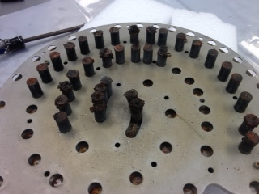
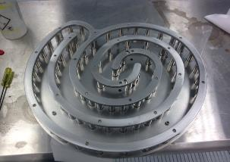
Pre and Post Pictures of G12 Magnet 0010-20768
Notice the deteriorated poles in the Pre Picture
Magnets are replaced with Ni Coated magnets vs Teflon coated

Slide 11
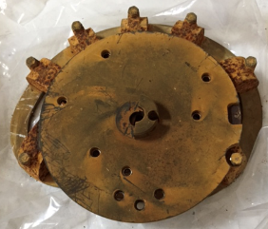
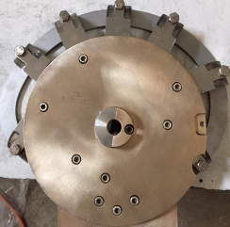
Pre and Post Pictures of Magnet 0010-20225
Notice the deteriorated poles in the Pre Picture
Magnets are replaced new AlNiCo magnets

Slide 12
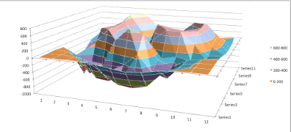
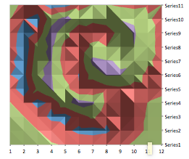
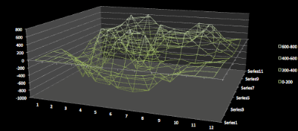
Sample of a 3D Gaussian Report

