Slide 1
Solid State HDD
Higher speed, more reliable and modernized hard drive replacement

Slide 2
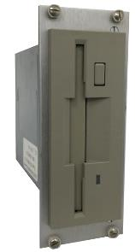
AMAT Compatible Hard Drives
Current technology is approaching 35 years old
Data transfer rates are extremely slow

Slide 3
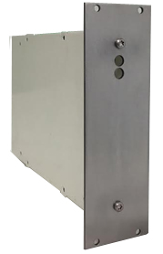
Replacement Solid State Floppy Drives
Uses Compact Flash technology
Data transfer rates are tremendously faster
Form factor is identical, units are plug and play and transparent to system

