Slide 1
Shutter Kits
Repair
Replace/ Provide
Configuration

Slide 2
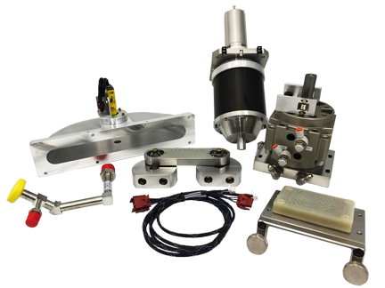
Shutter Kit Repair
Evets can repair each of the following sub assemblies for the shutter kits:
Magnetic Rotation (0010-21393)
Pneumatic Drive (0010-21264)
Shutter Enclosure “Doghouse” (0010-20985)
Shutter Bar Linkage (0010-21336)
Shutter Harness (0140-20693)
Shutter Manometer “Tree” (0050-24751)

Slide 3
Shutter Kit Repair Continued..
Repairs to Linkage include new bearings.
Repairs to Magnetic Rotation include new bearings and magnets.
Repairs to Pneumatic Cylinders include new seal kits, water fittings, and air fittings.
Shutter enclosure involves new O-rings and a new shutter disk sensor.
Evets has the capabilities of welding ½” tubing. Repairs to a existing manometer tree that is leaking is possible without buying a new one.

Slide 4
Replacing a Shutter Kit
Evets is capable of sending all brand new assemblies of shutter kits. We build and manufacture them in house. We guarantee our products are just as good as OEM.
Assemblies are set up and tested before shipping them to your facility.
We can provide an entire new kit, or just the part that has failed.
Install is also available at a separate cost.

Slide 5
Configuration
Evets is very experienced when it comes to shutter kits. We know exactly how to set them up and configure the software.
We have on-call support if a customer needs help properly setting up the shutter kit.
Configuring the shutter correctly is key when getting the full function of the process.

Slide 6
In Conclusion
Shutter Kits provide a massive time savings when burning in a chamber. Shutters allow you to strike on a separate pedestal, rather than a wafer. Shutter Kits are extremely cost effective. These kits have proven to save Fabs a lot of money and time.
Pricing and lead times are available upon request. Evets Global can provide you fast lead times and competitive pricing.

