Slide 1
Gasline Weldment Construction
Stainless steel gasline orbital welding.

Slide 2
Gasline Weldment Construction
Swagelok Certified Welding Personnel
Specializing in 1/8”, 1/4”, 3/8” and 1/2” diameters
Can copy existing lines or manufacture to customer specific dimensions
Several gaslines already drawn and cataloged by manufacturer’s part number

Slide 3
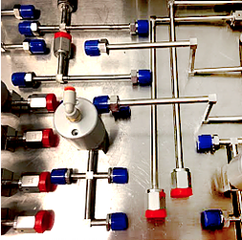
Previous Projects: Heated TxZ Gaslines
Construct all new weldments and apply thermal wrapping.
Superior heat conductance and control from improved spiral wrapped heat tape.

Slide 4
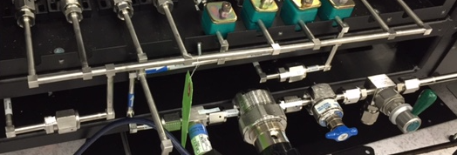
Previous Projects: Complete Endura Gaslines
Construct all new weldments for mainframe and all PVD chambers

Slide 5
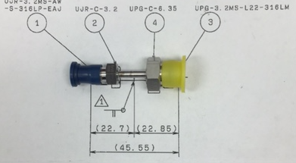
Previous Projects: Custom 1/8” gasline
Construct new weldment for a customer from a drawing

