Slide 1
Power Supply Repair
High capacity power supplies for Endura and Centura tools.

Slide 2
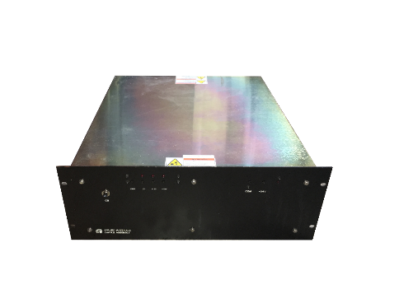
Power Supply Repair
Evets Global repairs many types of power supplies most commonly:
15v power supplies (internal and external)
24v power supplies

