Slide 1

Slit-Valve
Actuators
Repair and rebuilding Slit-Valve assemblies

Slide 2
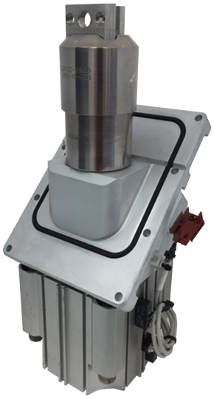
Repairs
Evets Global is capable of repairing
an entire slit-valve actuator, from the
bellows to the pneumatic cylinder.
Here are some key parts:
  Bellows cleaning
  Aluminum body cleaning
  Cleaning of O-ring groove
  New shaft seal kits for pneumatic cylinder
  New air fittings

Slide 3
Supply
Evets carries an inventory of all slit-valve actuator parts. We also keep a stock of new and refurbished slit-valves. We accept a core for a replacement slit-valves at a lesser cost to the customer.
Pricing and lead times are available upon request

